Slide 1

PRESENTATION ON
Internet connectivity
PRESENTED BY: PRADIP NIROULA

Slide 2


introduction
It the ability of a device to connect to the internet, allowing access to online resources, communication, and data exchange.

Slide 3

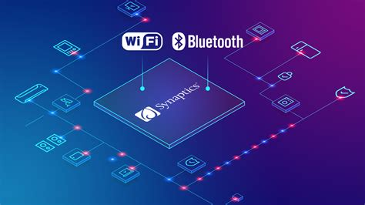
Types of
internet connectivity
Wired
Wireless

Slide 4
Wired internet
connectivity
Wired internet connections use physical cables for data transmission, ensuring stable and reliable connectivity with minimal interference.
01
02
03
Cable Internet
Fiber Optic
Ethernet (LAN)
It delivers internet through coaxial cables (like TV cables), offering high-speed internet with good reliability.
It uses thin glass fibers to transmit data as light signals, providing ultra-fast speeds (up to 10 Gbps) and low latency, making it ideal for high-performance tasks like gaming and streaming.
It connects devices within a local area network (LAN) using Ethernet cables, ensuring fast and secure data transfer.

Slide 5
Wireless internet
connectivity
Wireless internet connections use radio waves, satellites, or other wireless signals to transmit data without physical cables, making them flexible and accessible in different locations.
01
02
03
Wi-Fi
Mobile Data
Bluetooth and Hotspot
It is a wireless local area network (WLAN) technology that allows multiple devices to connect to the internet using a router. Common in homes, offices, and public places.
It uses cellular networks to provide internet access on mobile devices. 5G offers the highest speeds and lowest latency.
Bluetooth enables short-range wireless communication between devices, while a hotspot allows a mobile device to share its internet connection with others using Wi-Fi technology.

Slide 6
Thank you

